Slide 1
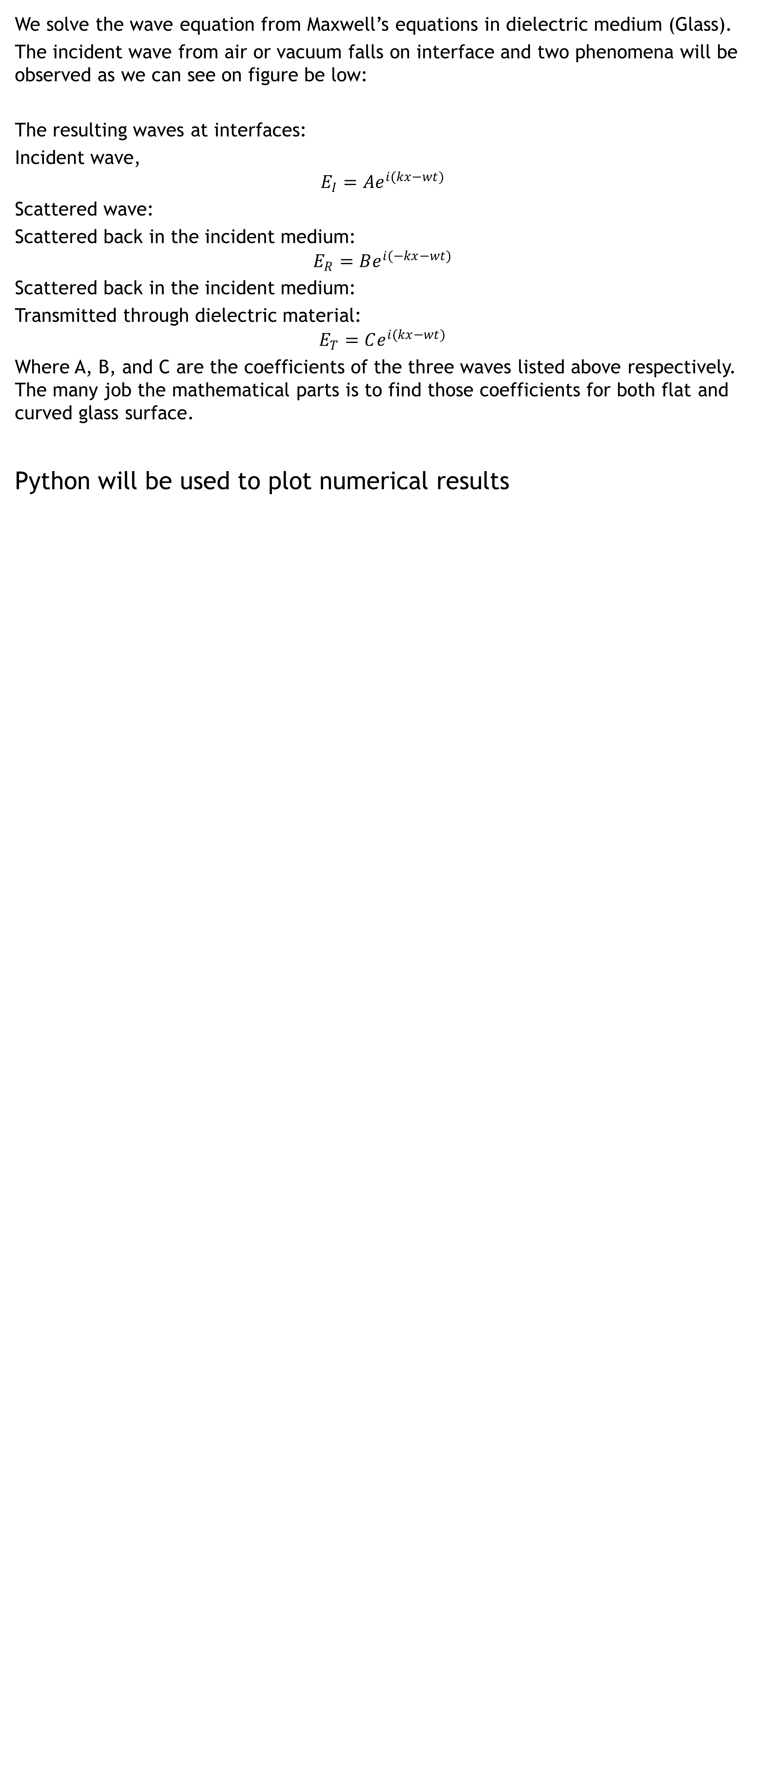


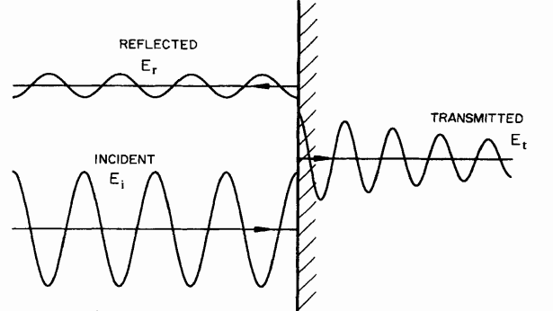
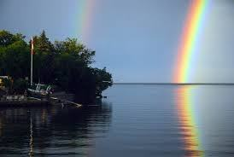
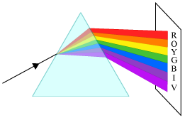
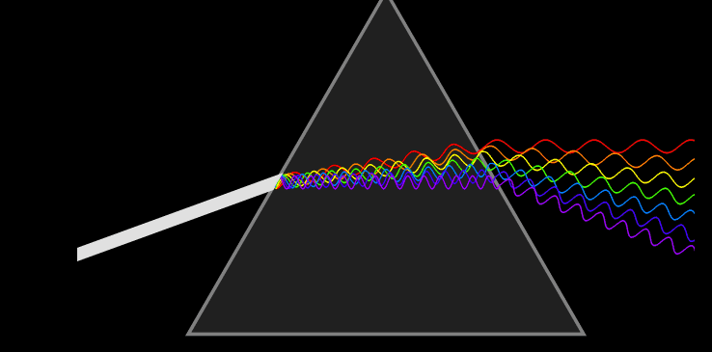
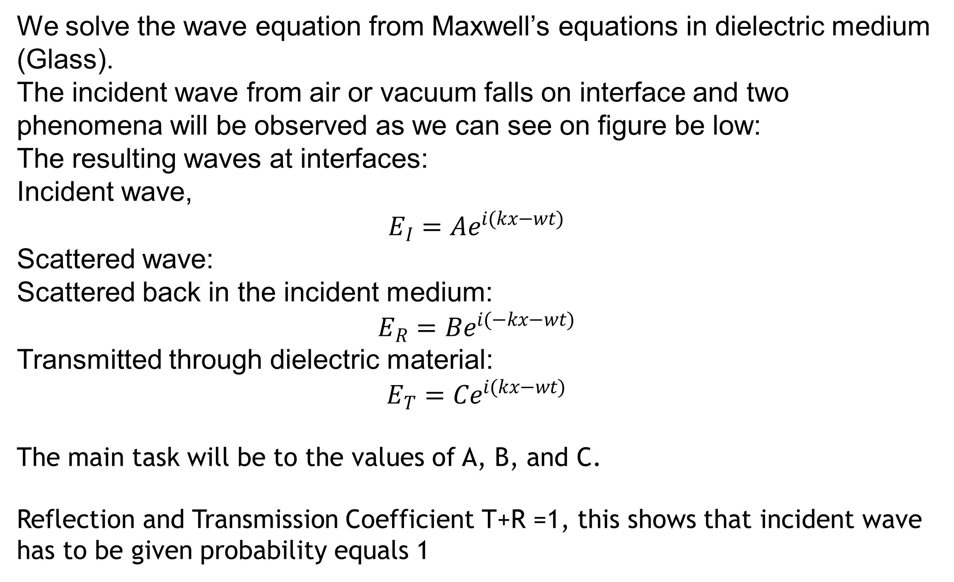
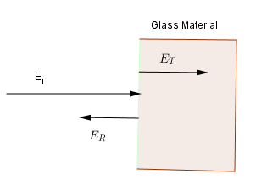
SCATTERING OF ELECTROMAGNETIC WAVES FROM FLAT SURFACE OF GLASS MATERIAL
Felix Ndayisabye, Pierre Nzabahimana,
ª Electricity and Magnetism PHY482
MSU, Department of Physics and Astronomy, MI 48824, BPS, Wilson Rd
Introduction
Like other radiation such as sound waves, electromagnetic waves are the well known forms of radiation that undergo scattering.
The electromagnetic wave scattering have got several applications, for instance: sunlight is scattered from rain drops to form the rainbow, radio waves are scattered by radar which has the application in telecommunication, and infrared radiation from an infrared camera is scattered by the target to get a picture this is applied in remote sensing.
The electromagnetic waves scattering can occur from different surfaces shape such as; flat surface, cylindrical surface and spherical surfaces.
The focus of our research is the light scattering model on the flat and curved surface of the glass materials. The figure below are examples of the application of light scattering.
Fig1. Rainbow and light dispersion are the example of light scattering
Results and discussion.
Fig3: Incident, Reflected and Transmitted wave
Reflection and transmission coefficient will be calculated as they are measure of fraction of the incident energy that is reflected and transmitted, respectively. The model will tells us how much wave scattered backward in the incident medium and how much wave scattered forward in the second medium. The good thing is that this model will be employed to study the white light scattering in glass medium.
Methodology
Fig2. The figure shows that the wave of different color scattered differently depending on their wavelengths. this the case of .
By using the appropriate boundary conditions through Maxwell's equations, all three
Fundamental laws of geometrical optics are hold for waves and due to different medium
Light can scatter through glass or in droplet of water in results rainbow according to their
wavelength.
Conclusion
References
Fig2. Diagram to demonstrate two kind of scattered wave when electromagnetic wave (light) falls on interface.
Reflection and Transmission Coefficient T+R =1
The plot we will be plotted by python.
Kerker, Milton. The scattering of light and other electromagnetic radiation. Elsevier, 2016.
Oguchi, Tomohiro. "Electromagnetic wave propagation and scattering in rain and other
hydrometeors." Proceedings of the IEEE 71.9 (1983): 1029-1078.

